Slide 1
What is next?
MinION sequencing

Slide 2
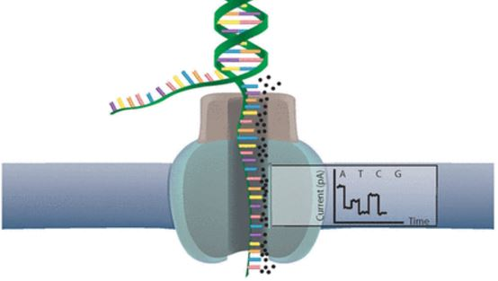
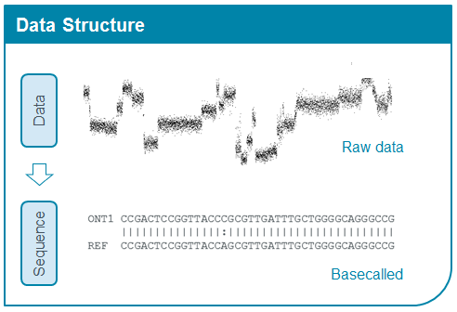

Slide 3
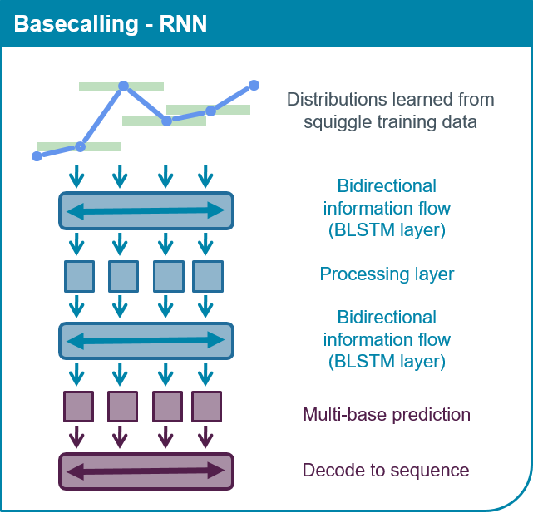
Reccurent Neural Network (RNN) – works like your brain! It can learn on the previous data and improve its performance on new data
Nanopore basecallers are trained on many sequenced data, so you can run it on your data even if you are sequencing first time

Slide 4
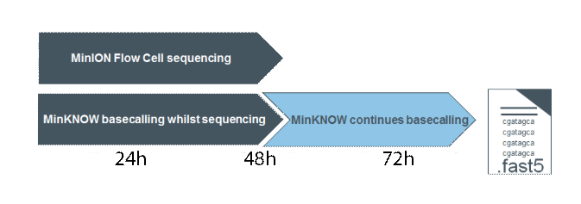
MinION sequencing
is controlled by MinKNOW software
MinKNOW runs basecalling in parralel
If you stop sequencing
MinKNOW stops basecalling !!!
Continue with Albacore software (offline)

Slide 5
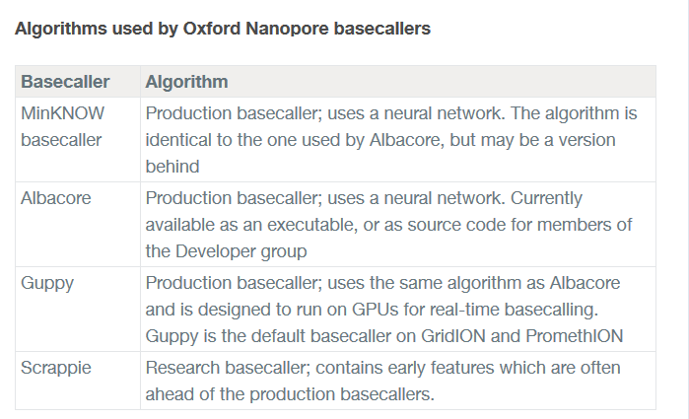

Slide 6
Albacore features
contains configuration files for basecalling chemistry that is not currently handled by MinKNOW, e.g. 1D2 reads
allows experiments with barcoding
The user can provide a reference file in FASTA, lastdb or minimap2 index format. If so, the reads are aligned against this reference
You need to know ‘command line’ to use Albacore basecaller!

Slide 7
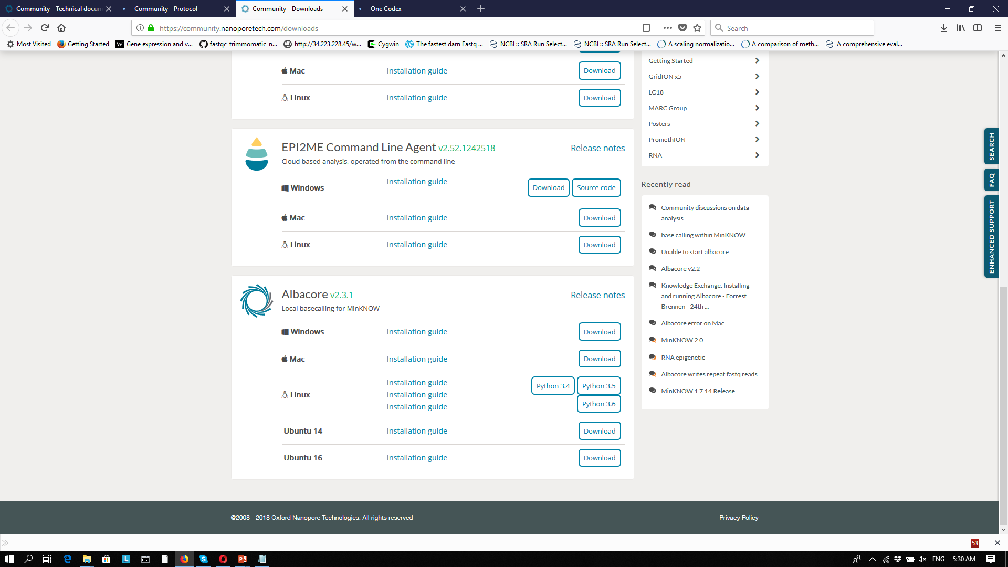
Albacore downloads

Slide 8
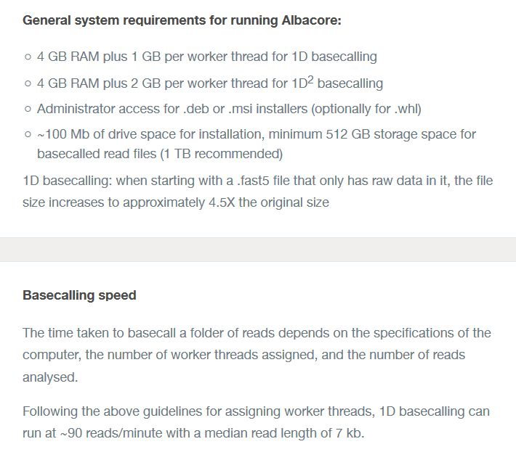

Slide 9
Albacore features
Number of CPU: how powerful your computer is and how fast you can run software
How to wisely use computational power: balance between the number of CPU and memory capacity. If your computer has 4 CPUs, you can type in the Albacore command ‘8 CPUs’ if the memory is enough. This means your computer has 1Gb memory for each working core (8 Gb in this case) plus 4 Gb as basic memory
Command for Albacore run:
“C:\Program Files\Oxford Nanopore\ont Albacore\read_fast5_basecaller.exe"
--flowcell FLO-MIN107 --kit SQK-LSK108 --barcoding --output_format fast5,fastq --input directory_of_fast5_files --save_path directory_for_output --worker_threads 4 -r
*for 1D² reads the script will be “full_1dsq_basecaller.exe”
Help on how to run Albacore:
read_fast5_basecaller.exe –h or read_fast5_basecaller.exe --help

Slide 10
Mind gaps in command line! “quotes save from blanks”, otherwise the program may be confused…

Slide 11
Albacore features
Number of CPU: how powerful your computer is and how fast you can run software
How to wisely use computational power: balance between the number of CPU and memory capacity. If your computer has 4 CPUs, you can type in the Albacore command ‘8 CPUs’ if the memory is enough. This means your computer has 1Gb memory for each working core (8 Gb in this case) plus 4 Gb as basic memory
Command for Albacore run:
“C:\Program Files\Oxford Nanopore\ont Albacore\read_fast5_basecaller.exe"
--flowcell FLO-MIN107 --kit SQK-LSK108 --barcoding --output_format fast5,fastq --input directory_of_fast5_files --save_path directory_for_output --worker_threads 4
*for 1D² reads the script will be “full_1dsq_basecaller.exe”
Help command with some usefull info about the run parameters:
read_fast5_basecaller.exe –h or read_fast5_basecaller.exe --help

Slide 12
NanoPipe – interactive tool for MinION sequencing analysis
Summer School “The MinIon Sequencing”
Manado, July 4-7 2018
Victoria Shabardina

Slide 13
Nanopipe is a web-based tool for fast and easy processing
and analysis of the MinION sequencing data.
Created in the Institute of Bioinformatics, University of Münster, Germany

Slide 14
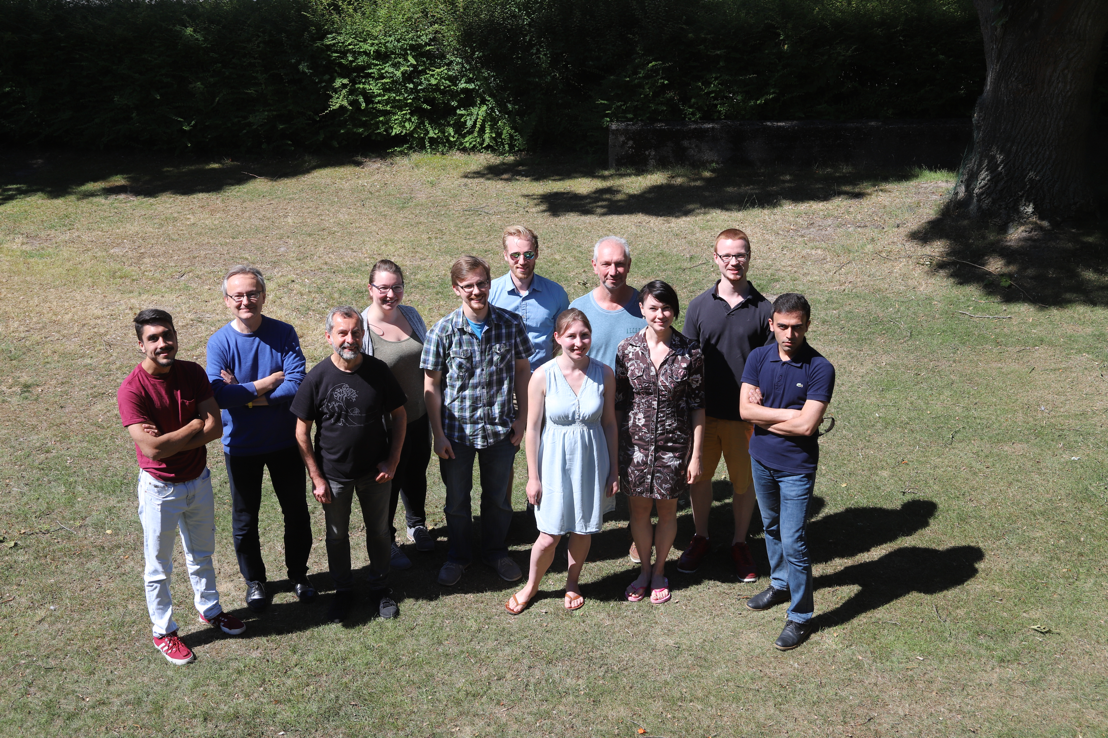

Slide 15

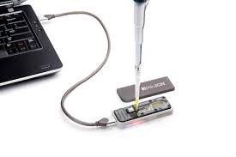
1977
Elegance of the technical progress ;)
2017
2m

Slide 16
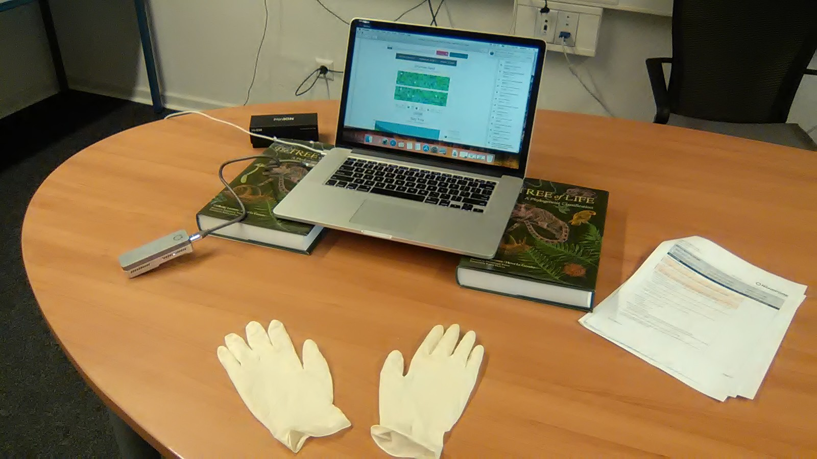
Institute of Bioinformatics:

Slide 17
Basecalling
Electric signal
.fast5 file
HDF viewer
Real-time MinKnow
or
Albacore basecalling
.fastq file
.fasta file
Bioinformatics
analysis

Slide 18
.fast5 file format
.fast5 is a type of the Hierarchical Data Format (HDF) and designed for the storage of big datasets
It is binary – not readable by human
HDFview – the tool to see HGF files:
.fastq file format
Each entry consists of 4 lines:
1 @header_name_of_sequence/read
2 sequence
3 +
4 quality (coded by ASCII symbols: https://en.wikipedia.org/wiki/FASTQ_format#Encoding)
Poretools is the tool developed for MinION to convert .fasta5 files to .fastq or .fasta files
Albacore basecaller allows generating directly .fast5 or .fastq files ☺

Slide 19
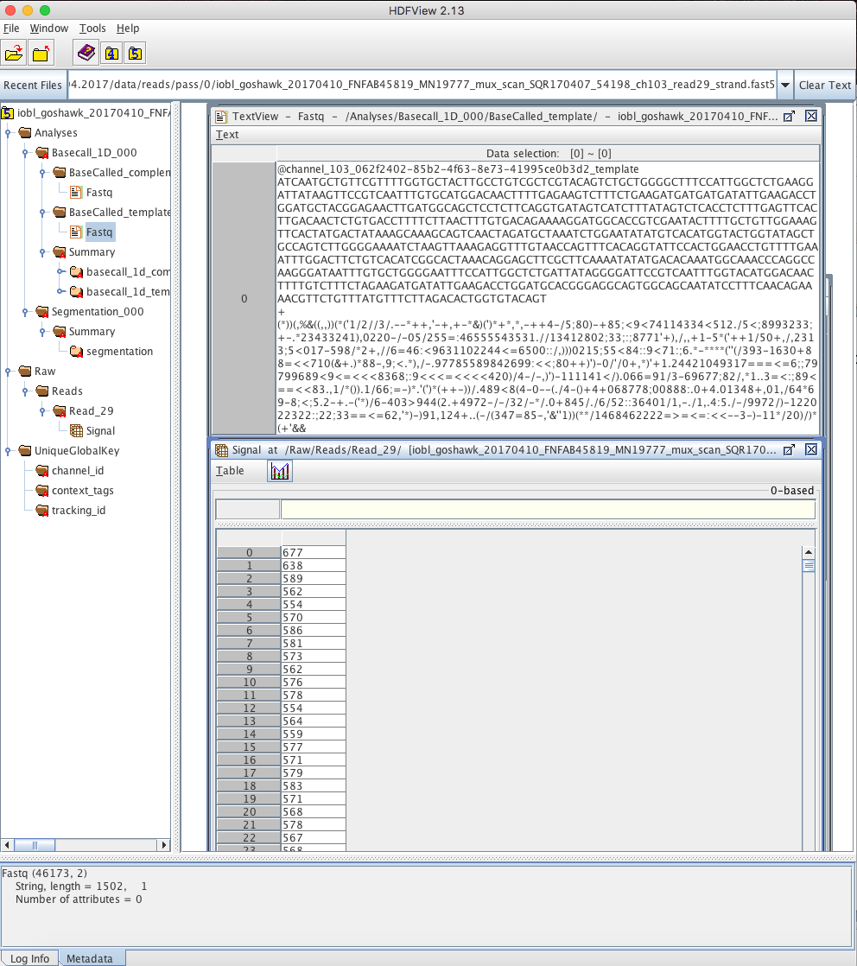
HDFviewer window:
(software source:
https://support.hdfgroup.org)
.fastq file
(contains base quality info)
Raw signal
(current from a MinIon channel)

Slide 20
.fasta file format
contains 2 lines:
1 >header
2 sequence
>ff6c98dd-bce9-4a2b-bf13-081841413c94_Basecall_2D_minion_20170511_Ae_aegypti
GCGCTGGTTCAGTTACATATTGCTAGGGTTAAGCAGTGGTGACCACAGATTTTTATGATTTATGGATT
CTTTTCTTCTGGCTACATTACTGGAACAGAGCCTGCTTCTCAACAGTGTTCTTATGAACGCTTCAGCTTA
GTATAAAGGC
>4c8a2487-0e13-41a6-ac7b-6cd2fbf5eb95_Basecall_2D_minion_20170511_Ae_aegypti
TACGCGGTGACAAAAACGTGCGTACCGGCAACCGCATGTTGAAACAGGAAAACGTACAAAGGACCC
TCGCAAAATGCGCGACAAAATCTGCAACGTACAACATGCGATAAACGTGCGTGAGGAGATC
>…..
………..
> sing is convenient marker to browse through the .fasta files

Slide 21
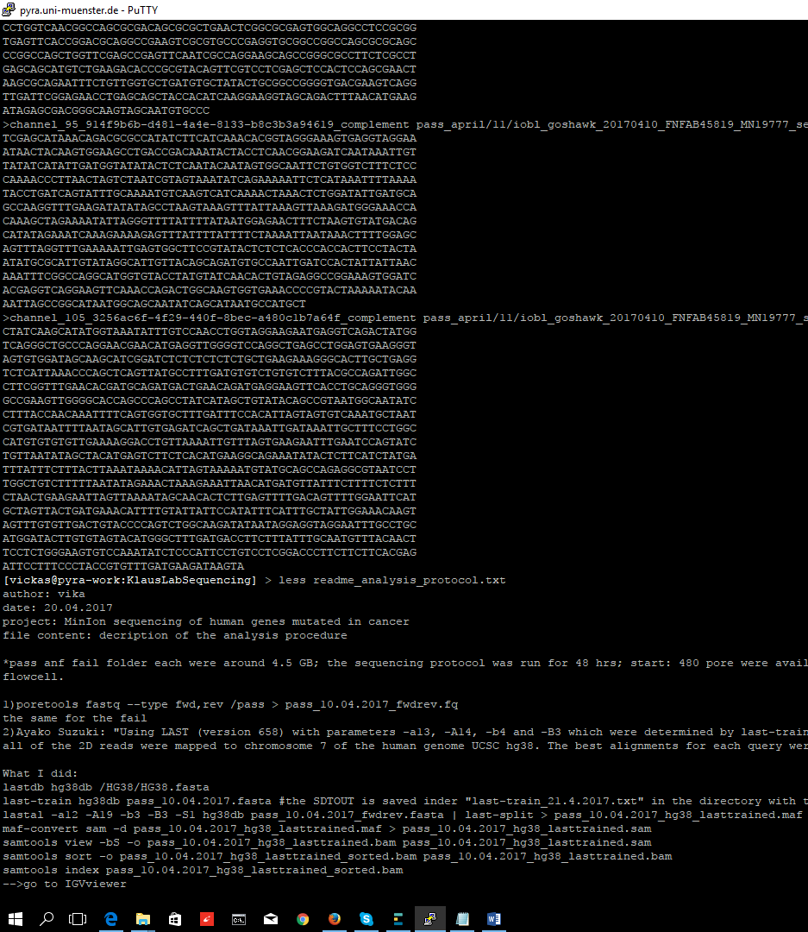
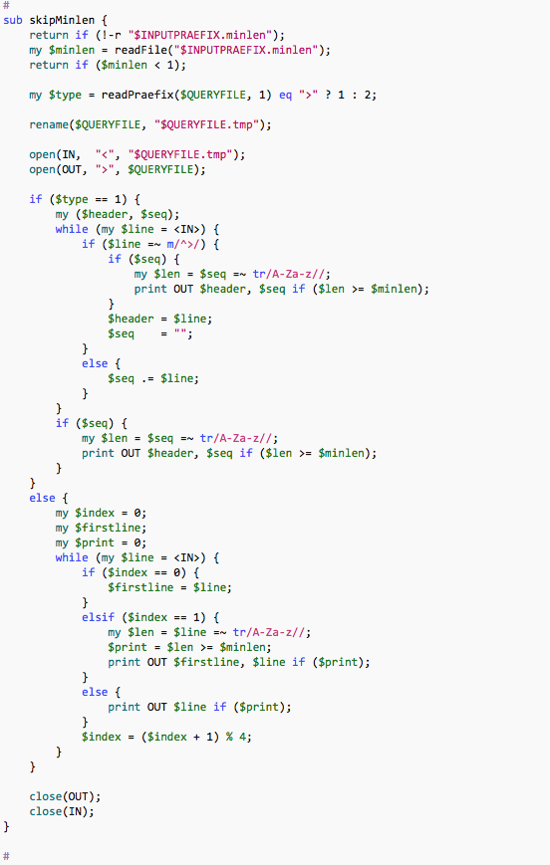
Nanopipe from Münster: why is it a pipe?

Slide 22
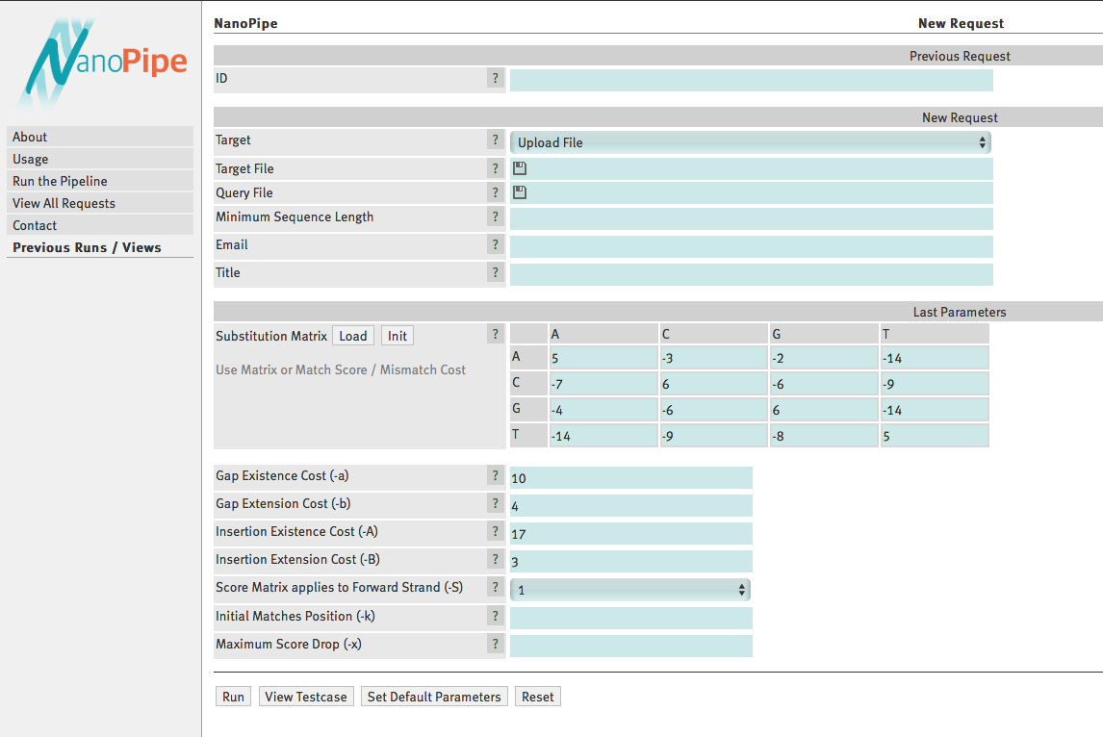
Web interface

Slide 23
NanoPipe2 workflow:
consensus-target
alignment
LAST
alignment
MinION reads
Target
nucleotides
count
per position
consensus
nucleotide plots
alignment
statistics
BAM files
polymorphisms

Slide 24
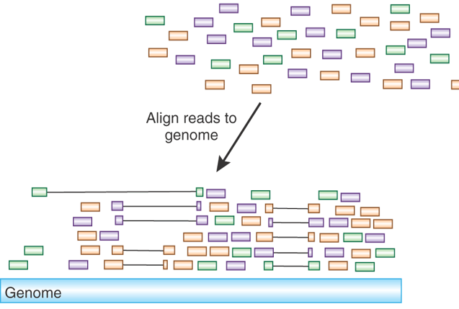

Key steps of Nanopipe
1) LAST sequence aligner maps MinIon-produced reads to a target (selected region, exon, gene, genome)
Martin Frith
University of Tokyo,
Division of Biosciences
Other aligners: BLAST (psi-BLAST, delta-BLAST), HMMER, MUSCLE, MAFFT…
File formats that are important to know when working with mapped reads:
.maf
.sam
.bam

Slide 25
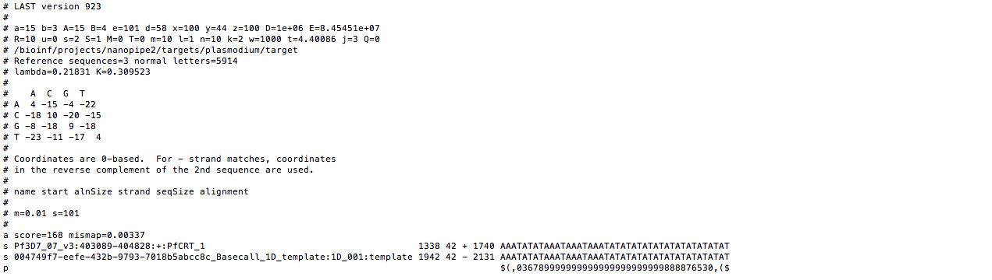
.maf file format – shows pairs of aligned sequences with the coordinates

Slide 26
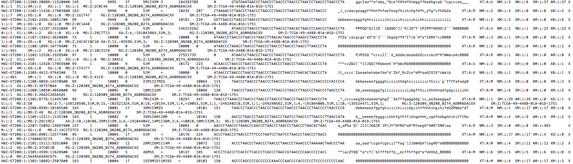
.bam and .sam file format – informative about alignment of sequences to a target
.bam is a binary file (humans can not read), it contains a lot of information about the alignment.
Important part is the HEADER and FLAGs specifications
(https://broadinstitute.github.io/picard/explain-flags.html)
.sam format is the readable version of .bam (some info is casted away):

Slide 27
Summary: files’ formats
Files’ formats used for storing sequences, sequencing results:
.fast5 – big, binary (cant read), contain a lot of metadata
.fastq – readable by human, contains sequences and sequence quality
.fasta – readable, contains sequences
Files’ formats used for storing results of sequence alignment:
.maf – contains pairs of aligned sequences with the alignment’s coordinates; for example, used by LAST
.bam – binary format, includes aligned sequences, coordinates, information about bioinformatics
processing, quality, …
.sam – human readable version of .bam, much bigger in size
.fastq/.fasta and .bam files are widely used in all DNA/RNA bioinformatics analysis

Slide 28
NanoPipe2 workflow:
consensus-target
alignment
LAST
alignment
MinION reads
Target
nucleotides
count
per position
consensus
logo plots
alignment
statistics
BAM files
polymorphisms

Slide 29
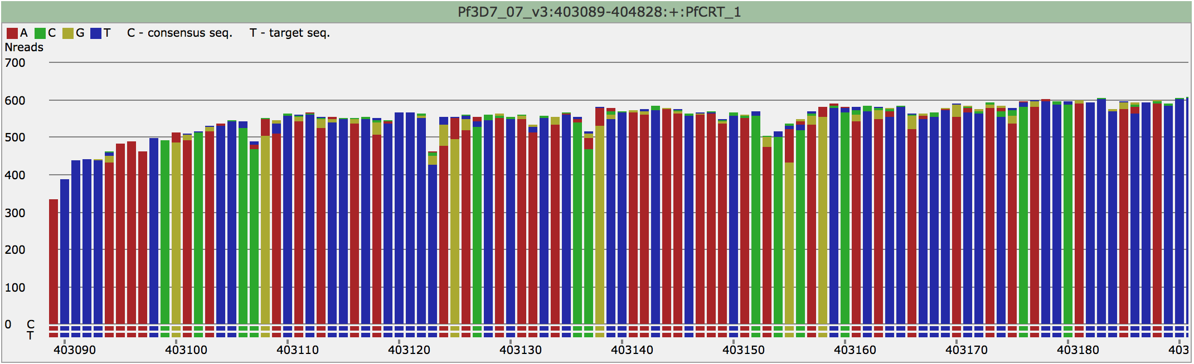
1)
What is Consensus Sequence?
– majority rule, i.e. If alternate nucleotide is >50%

Slide 30
Key steps of Nanopipe
2) Tracing potential mutations: nucleotide frequency at a particular position, the rule of 20%
3) Generating consensus sequence and comparing it to the target sequence position by position
In ambiguous situation NanoPipe2 uses IUPAC symbols,
for example, “R” means “A or G”, “Y” – for “C or T”
(see http://www.bioinformatics.org/sms/iupac.html or NanoPipe2 help-page:
http://bioinformatics.uni-muenster.de/tools/nanopipe/usage/ )
4) Additional files: .bam and .bam.bai for browsing in IGV-viewer

Slide 31
NanoPipe2 helps us to…
See if our sequencing worked: how many reads were mapped to the target and where
exactly, what part of each read mapped (Alignments length distribution)
Detect insertions/deletions and single nucleotide variations
Visualization of the experiment
Gives us the .fasta file with the consensus sequence of what has been sequensed
and .bam file that can be used in further analyses if needed

Slide 32
Reads quality
NanoPipe2 doesn’t tell us anything about the reads quality, i.e. how good MinION performed its job
Simple to use and freely downloadable software – FASTQC – can do it!
Download FASTQC: http://www.bioinformatics.babraham.ac.uk/projects/fastqc/

Slide 33
Tools from Oxford Nanopore
Metagenomics analysis: identifying different taxa in mixed samples (soil, food, human mucus,…)
EPI2ME → WIMP (“what is in my pot”) : prokaryotes, fungi, archaea
Bioinformatics cluster
(amazon cloud based) → S16 : eukaryotes, prokaryotes, fungi, archaea

Slide 34
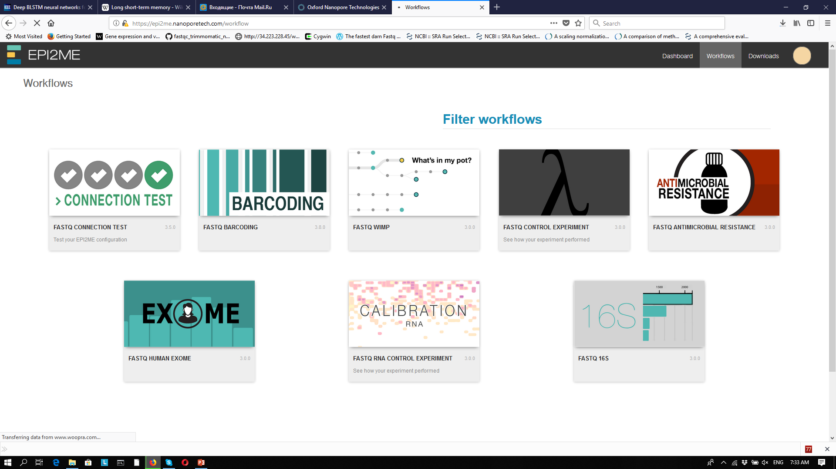
Metrichor Ltd has developed the EPI2ME platform to enable real-time, cloud based analysis of biological data

Slide 35
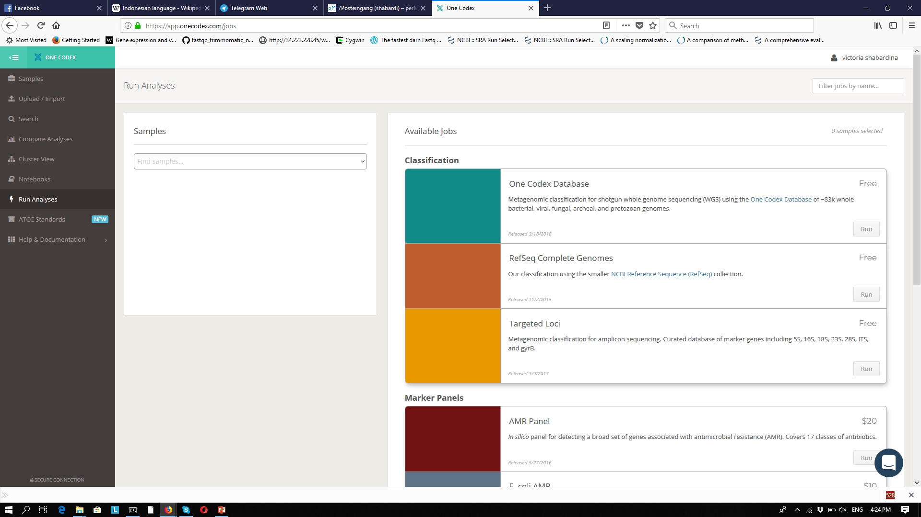
OneCodex onecodex.com

Slide 36
Practical session
Go to http://bioinformatics.uni-muenster.de/tools/nanopipe2/
and to onecodex.com for the metagenomics analysis

Slide 37

Usage of the Windows’ command line
*another hint: for the present version of NanoPipe (of July 2017) it is possible to upload only
one file in the “Query File” field. But after sequencing and Albacore base-calling you get many
files with your reads. So, there is necessity to merge these multiple files in one. It can be done
in the so called Command Line. If you are using Linux or Mac OS, you know how to do it ;)
If you work on Windows computers you might need some explanations. Here they are:
Find in your computer “command prompt” using the search tool –
- Open prompt window and type command ‘cd’ in the Prompt to go to the folder where you keep your sequences.
I.e. type ‘cd /C:/MinIon/sequences(path to your reads)’ then press “Enter” to execute it.
To see the content of the folder print ‘dir’ and then hit “Enter” to execute the command
Finally, to merge the files: print ‘type *.fastq > all.fastq’ and hit “Enter”. This will create the new file “all.fastq”
with all sequensed reads. Use this file for NanoPipe2 analysis.
(If any problems – you can always find help by googling or start with reading https://community.sophos.com/kb/en-us/13195)

Slide 38
Find the PDF with the presentations here:
http://www.bioinformatics.uni-muenster.de/home/presentations

